Slide 1
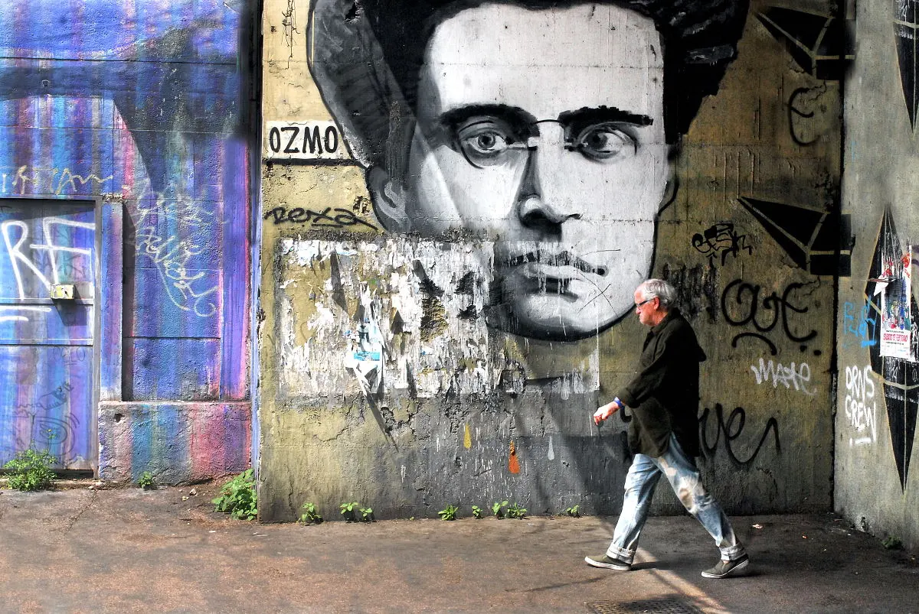
Antonio Gramsci
21 April 2020
GENTRAIN
MONTEREY PENINSULA COLLEGE
STEPHANIE SPOTO

Slide 2
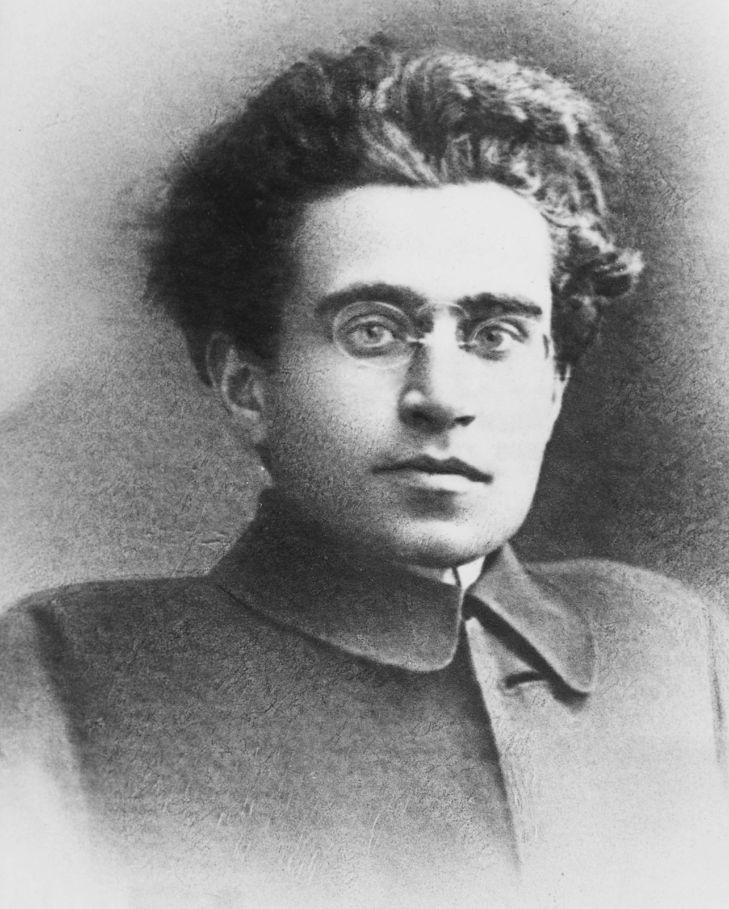
Antonio Gramsci (1891-1937)
Leading Marxist intellectual and philosopher – Marxist tradition
Journalist and major 20th century theorists
Spent his last 11 years in one of Mussolini’s prisons
Prison Notebooks: while imprisoned he filled 32 notebooks, with almost 3,000 pages.
Smuggled in secret out of prison – published in Italian after WWII
English language publication not until the 1970s
These notebooks demonstrate his thought and ideas around the creation of a new Marxist theory that better relates to the conditions of capitalism in the 20th century.

Slide 3
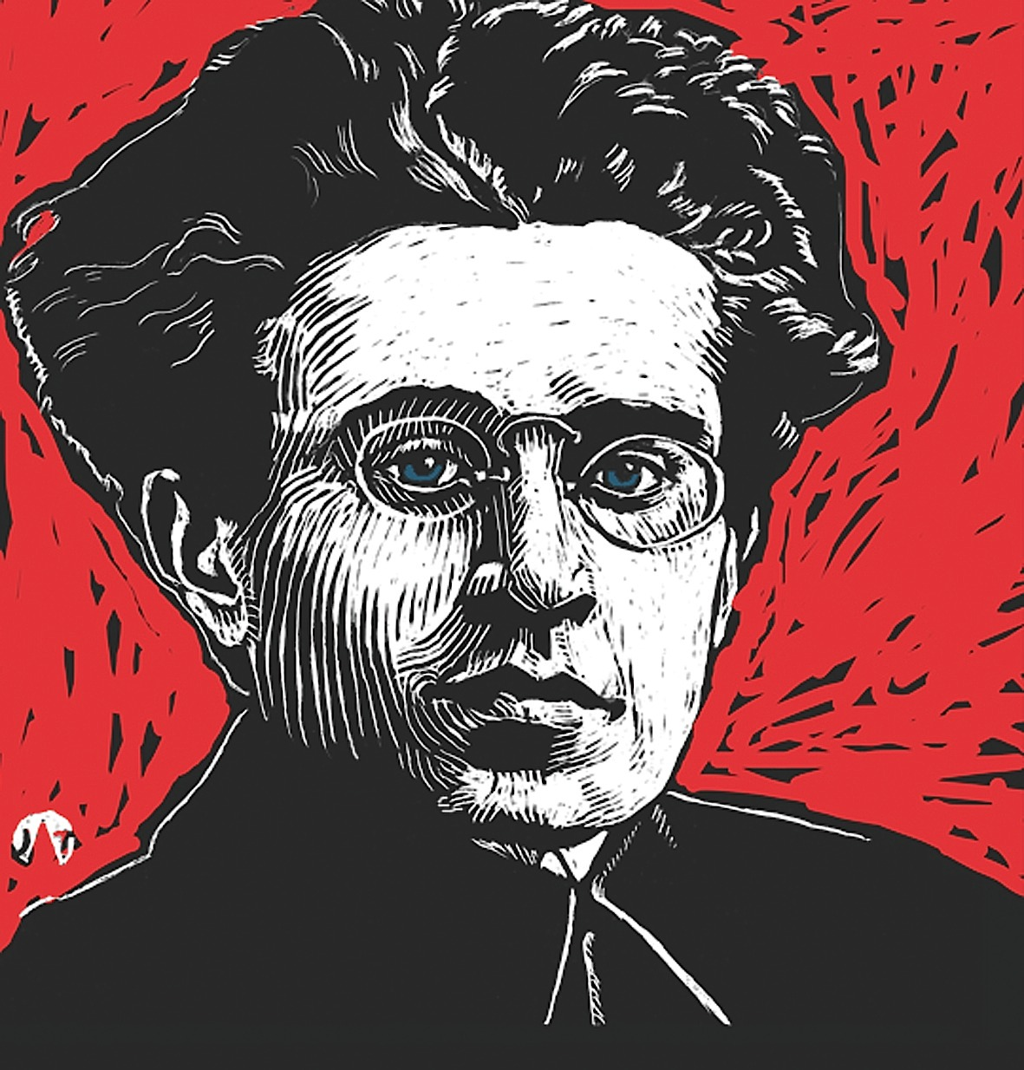
Early life and introduction to political philosophy
Born on Sardinia (Italy), 1891
Unlike most people on the island, his family was literate, and Gramsci did well in school → earned a scholarship to the University of Turin
Southern Italy and the islands were more rural, with a large illiterate peasant class
Northern Italy was industrial and also had a politically aware working class
Turin has been described as the Red Capital of Italy (working class organized)
30% of the population were industrial workers (largely in automobile industry)
Hundreds of workers protests and strikes that culminated in the occupation of the factories in 1919 → set up workers councils to run the factories
These famous strikes have been the subject of films such as The Organizer (1963) and the ‘modernized’ The Working Classes Go to Heaven (1971)
This was the Turin which welcomed Gramsci when he went to university

Slide 4
General contributions
Gramsci became a socialist before he went to Turin → while still living in Sardinia, his brother had sent him socialist pamphlets from the mainland (socialist thought was expanded while at university)
Values: Went beyond merely propagandizing and political organizing → the first Marxist to theorize around the problems of twentieth century revolutionary change in Western Europe
Also, importantly, the first to identify the centrality of the struggle against bourgeois values → theorized about the ideological and cultural struggle
(In)formal education: Made important contributions for informal education
Theory of Hegemony: gives us a way to understand the context in which informal educators are acting (plus theorizes about the possibility of transformation)
Organic intellectual: Concerned for what he called “organic intellectuals” and its relation to informal education
Traditional schooling: Though informal education and organic intellectuals are important, we don’t need to dismiss traditional forms of education.

Slide 5
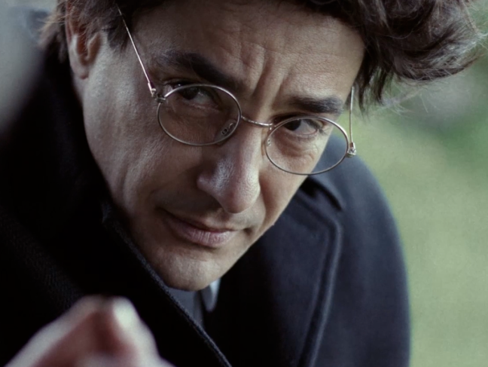
Philosophical Concepts: Hegemony
“Hegemony” was a term not coined by Gramsci → was already in use.
Vladimir Lenin used the term to refer to the political leadership of the working-classes in a revolution
Gramsci explored and expanded the concept beyond its earlier use.
Wanted to study and understand the way that the bourgeoisie (as the ruling capitalist class) establishes and maintains its control through values and propaganda.
Historical teleology and the inevitability of revolution (traditional Marxism) → but no revolution occurred in Europe…..why?
Gramsci explained that capitalism holds power and control not only through violence (see Walter Benjamin) and economic coercion (see Marx), but also through ideology and values.
Capitalist ruling class created a hegemonic culture, comprised and spreading its own values, ideology, and norms → so successful that it became “common sense” values to everyone (regardless of class)
Even the working classes identified the good of the ruling classes as their own good
This helped perpetuated the capitalist status quo rather than facilitating revolution
Peppino Mazzotta in Gramsci 44
Documentary about Gramsci’s 44 days imprisonment on the island of Ustica

Slide 6
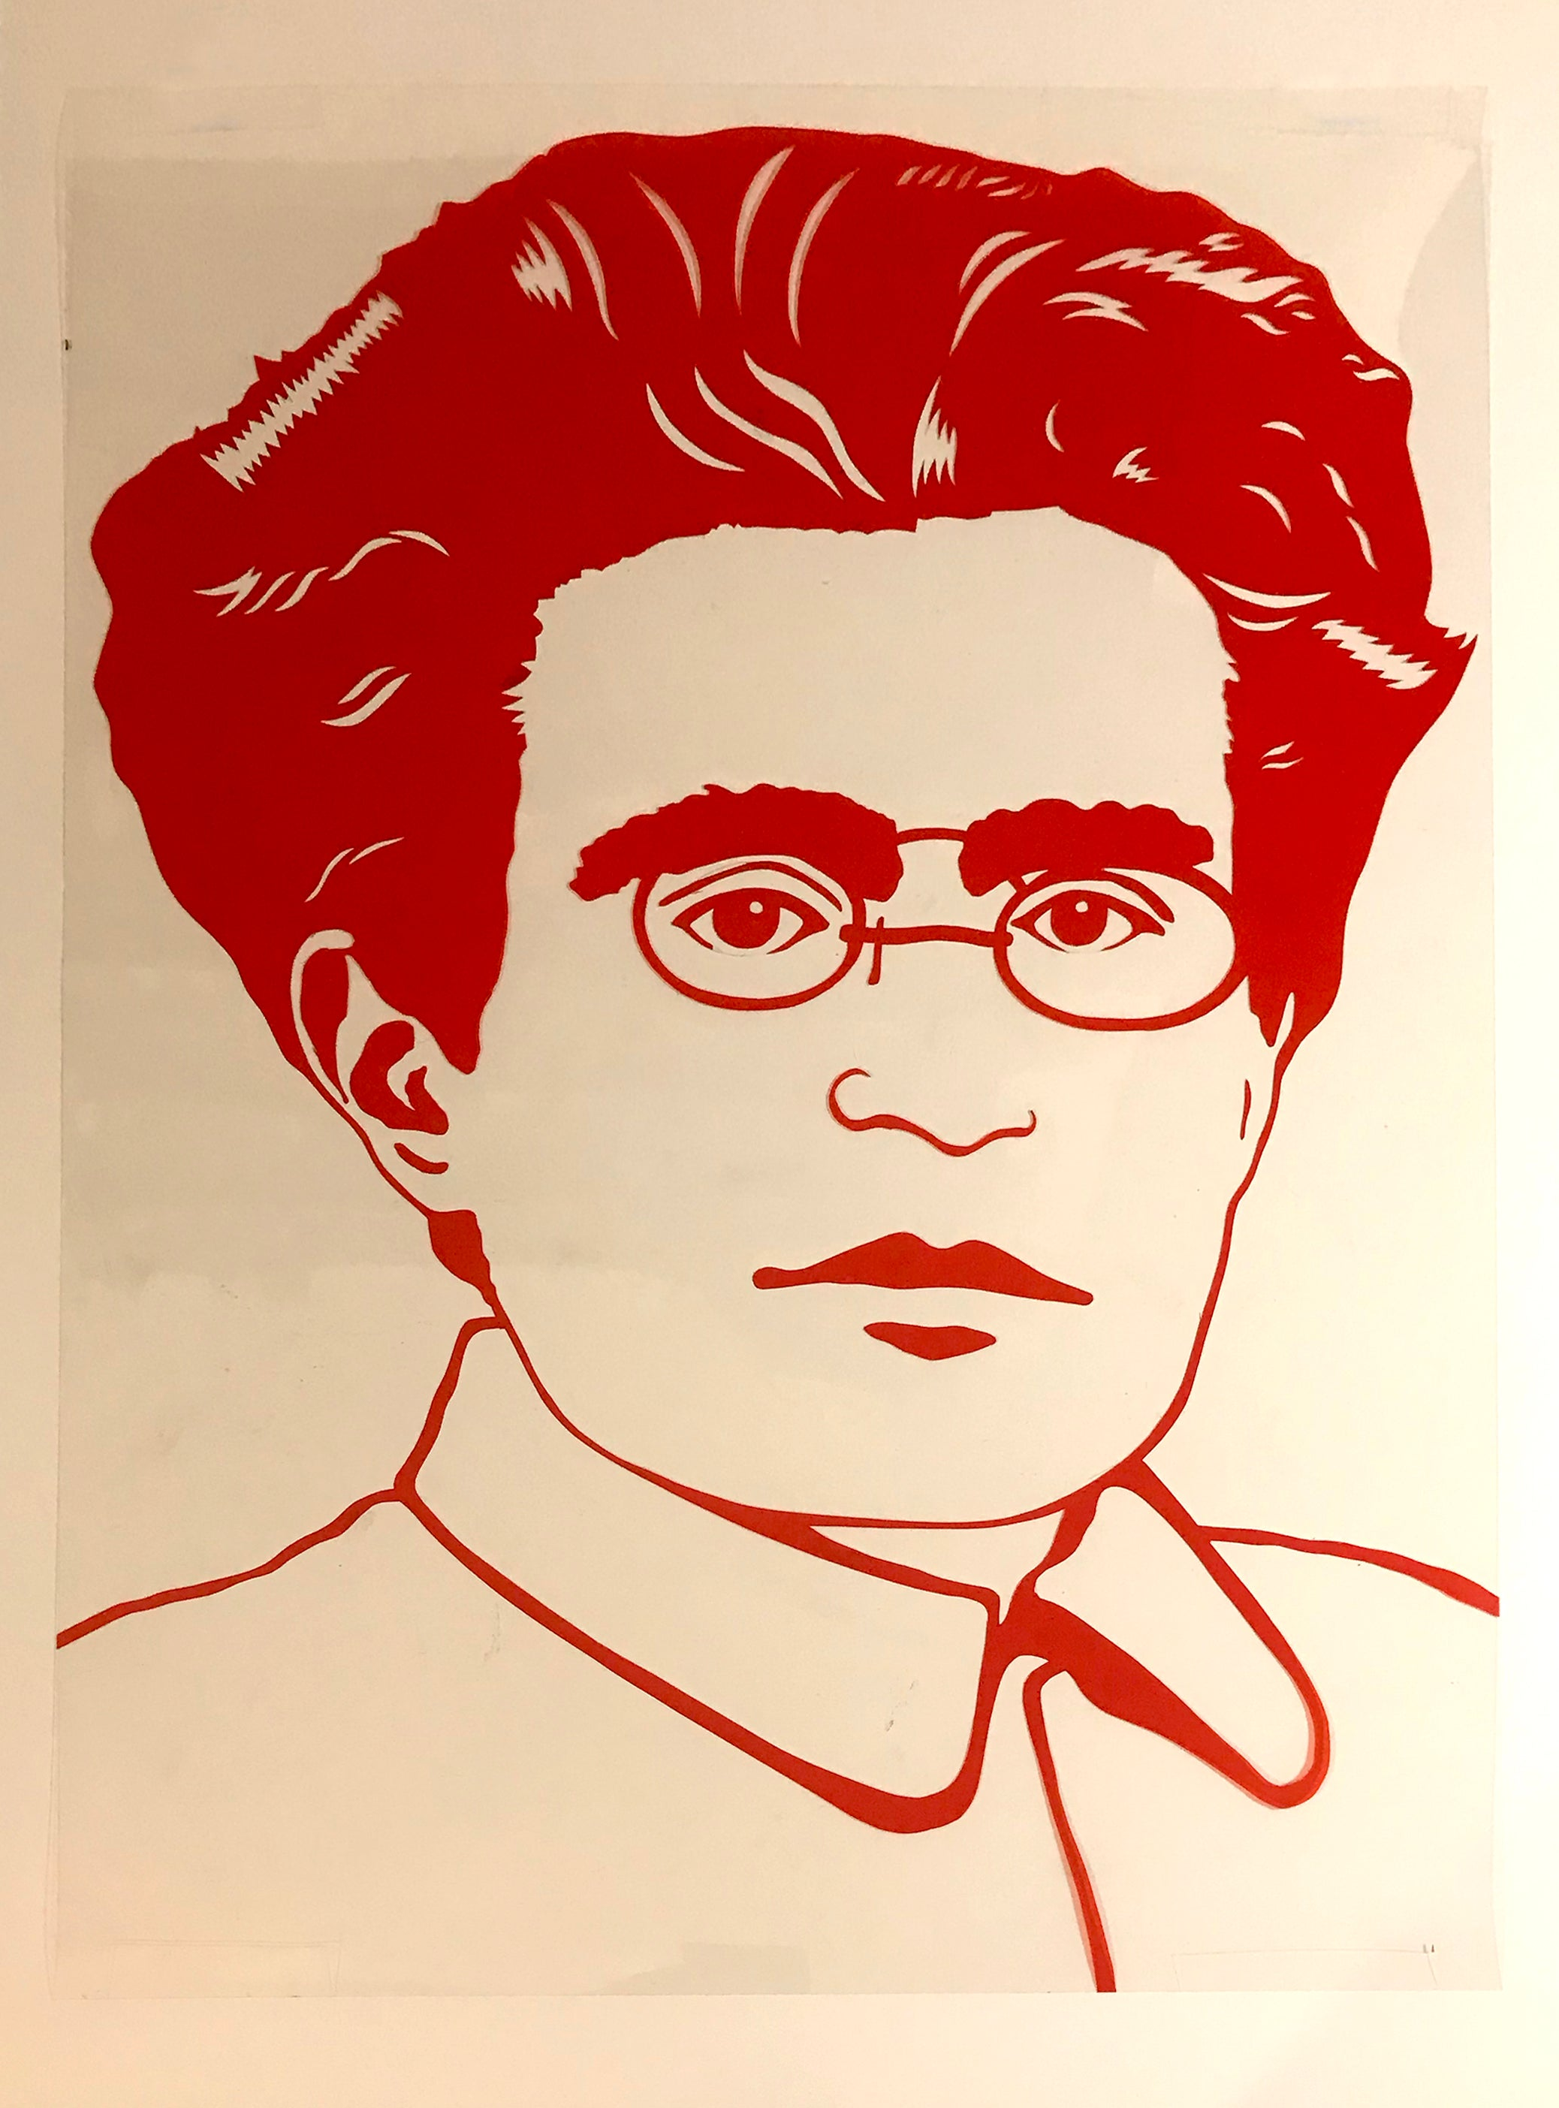
Philosophical Concepts: Hegemony The need for working-class culture
Working class culture needed:
Counter the ideology of bourgeois culture and its supposed naturalness or normalcy
Traditional Marxists like Lenin thought that culture was not as important for political struggle → but for Gramsci, cultural hegemony was needed before any take over of power is possible
A class cannot merely dominate and control in the modern world by simply advancing own economic interests → also not enough to control through force, violence, and coercion
Must make alliances, compromises, and assert intellectual leadership
Gramsci focuses analysis on the areas and institutions that prop up bourgeois cultural values:
Such as popular culture, mainstream religion, folklore
Sees the Roman Catholic Church as an impressive example of this kind of hegemonic influence: the church took great care to prevent any gap in interpretation of religion between the literate elites and the illiterate working classes.
According to Gramsci, Marxism is the coming together of two historical trends:
Renaissance Humanism
Populist elements of the Reformation
Marxism can only persist over religion if it meets the spiritual needs of the people → it would have to become an expression of their own lived experiences in order for that to happen.

Slide 7
Philosophical concept Historicism (The Philosophy of History)
Both Gramsci and Marx were ‘historicists’: theory and social life determined by history
Gramsci: meaning comes from the relationships between human activity and the social/historical processes of which it is a part
Also, preempted the “New Historicist” movement: ideas cannot be understood apart of their historical and social context → cannot be understood outside their origin.
Gramsci: we organize our understanding of the world through our social relations between the person and concepts → not through our knowledge of our relation to things (to an objective, verifiable reality).
Therefore, there is no such thing as static human nature → only historically changing social relationships
Science and philosophy cannot reflect a stable reality that is independent of us → we can only theorize about what can be thought of as true in a historical situation, what reflects current epistemology
Divergence from Marx: Most 19th century Marxists and 20th century Orthodox Marxists believed that truth was verifiable and was truth no matter where it is known → truth can be known and universally applied
Scientific truth and knowledge (which includes Marxism – which understands itself as a science) accumulates throughout history → progress
Traditional Marxism: economics and history are not part of the illusory world of the superstructure
Gramsci: diverged from this traditional Marxist view → Marxism is “true” in a very important way: it outlines the proletariat class consciousness.

Slide 8
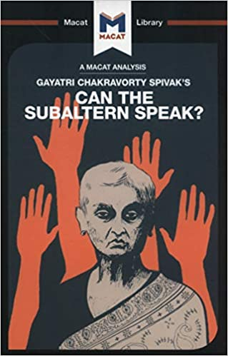
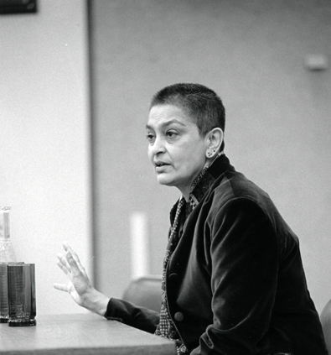
Philosophical concept: “subaltern” On intellectuals and on education
All people are intellectuals: each have intellectual faculties → but not all have the social role of intellectuals
Intellectuals: not talkers, but organizers who create hegemony through value apparatuses (e.g. education and media).
Wants to differentiate between two groups:
‘Intelligensia’: falsely sees itself as apart from society, in a different class, immune from class indoctrination
Organic intellectual: each class naturally produces intellectuals → not simply describing social and material life through science, but also through the rhetoric of feelings, experiences, and culture. Can articulate the experiences which the proletariat cannot express for themselves.
The duty of the ‘organic intellectual’: they must give language to their class’s common sense and folk wisdom → they must speak for and represent marginalized social groups.
These excluded social groups who cannot speak for themselves he calls the “subaltern”
Gayatri Spivak takes up Gramsci’s notion of the subaltern in one of the most important books of post-colonial critical theory of the late 20th century: Can the Subaltern Speak?

Slide 9
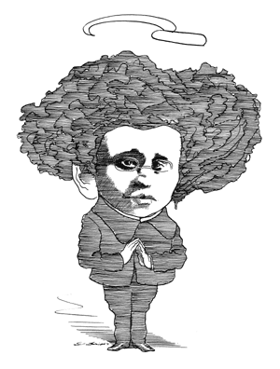
Philosophical concept: “subaltern” On intellectuals and on education
The organic intellectual challenges capitalist power by building counter-hegemony → this was part of the “war of position” → the working classes must create and perpetuate alternative ideologies and values to counter bourgeois ideology.
Gramsci called for an education that could foster working-class “organic” intellectuals → this would help further the goals of a counter-hegemonic working class ideology/culture
Rather than forcing Marxism onto the working classes, this new education would help hone pre-existing intellectual activity → foster critical perspectives of bourgeois ideologies and the status quo
Gramsci’s ideas about the organic intellectual and the role of the educator being to foster ideas that are already existing in communities would later on go on to influence the revolutionary educational theorist Paulo Freire and the postcolonial thinker Frantz Fanon.

Slide 10
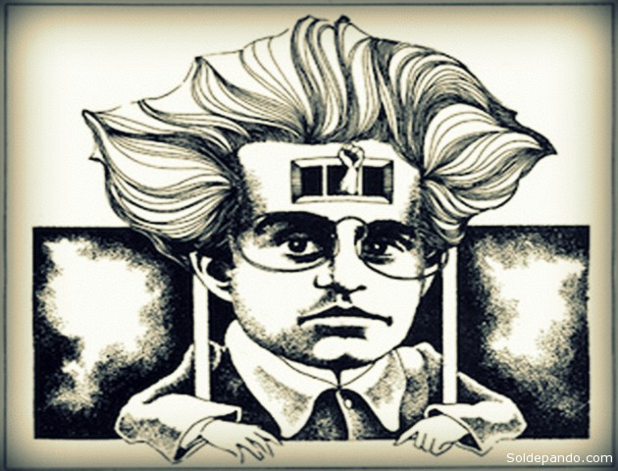
Critiquing Marx Against Marxist ‘Materialism’
Gramsci’s work runs counter to Engels, Lenin, and Marx’s theories of historical materialism.
Traditional Marxism: reality exists in itself, independent of human thought, observation, culture, etc.
Gramsci: Human history and collective activity create meaning – reality does not exist in itself
The belief in an objective reality outside of human history and activity is comparable to a belief in God.
No objectivity, but there can be a universal intersubjectivity in communism
Human history creates meaning – even for ‘natural history’
Objectivism, positivism, and philosophical materialism are all failures of imagination and critical thought → each fails to offer critique of superstition or religious ideology

Slide 11
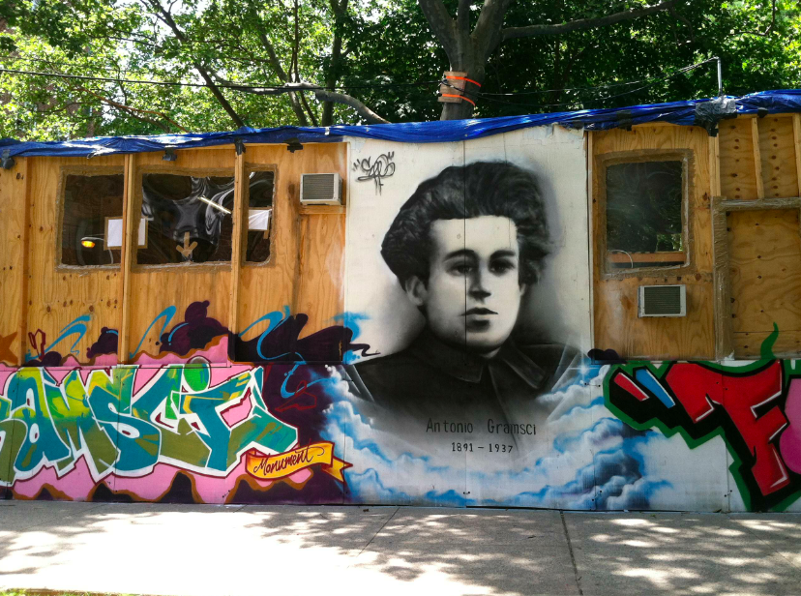
Gramsci’s influence
Gramsci is an important figure in twenty and twenty-first century critical theory and philosophy → esp. in discussions around the role of ideas in the construction and maintenance of power.
In particular, his idea of ‘hegemony’ has become widely cited in the fields of philosophy, critical theory, cultural studies, political theory, etc.
In political theory/political science, Gramsci is especially cited→ his influence is strong in the fields of international relations
Neo-Gramscianism: the study of how international politics and economics interact with institutions, ideas, values, and power → how these institutions shape state formation.
In academic/scholarly popular culture studies, Gramsci has been influential for possibilities for ideological resistance to the values and corporate interests perpetuated by the nation-state, governments, and corporations.
Criticisms of Gramsci: critics claim that he is creating a idea of power struggle through values/ideas/ideology
Gramscian/Neo-Gramscian methods and analysis are often reflected in controversies in universities → these ideological power struggles and controversies are sometimes considered to be counter to liberal inquiry and analysis, which is founded on the study of Western culture and traditions read in an apolitical way

Slide 12
Sources & Resources
Documentary made for Channel 4 Television (Scotland) about Antonio Gramsci: https://www.youtube.com/watch?v=51DhvS9abyI
‘New York and the Mystery of Naples: A Journey through Gramsci's World’. Documentary about Gramsci with interviews with today’s leading intellectuals about his importance and influence: https://www.youtube.com/watch?v=j3eL9TJM5BQ
Selections from The Prison Notebooks, available online for free here: http://abahlali.org/files/gramsci.pdf
Gayatri Spivak, “Can the Subaltern Speak?” selections available here: http://abahlali.org/files/Can_the_subaltern_speak.pdf

